Slide 1

Extra Duty Workflow Changes
Cost Center Managers
Notes:
You may have heard I had a crown for the Timekeepers because they are “ROYALLY AWESOME”. The Supervisors got the pirate hat because they ARRRRR in charge of keeping their site on course. As Cost Center Managers, y’all get the hard hat because you’re helping “BUILD” an approved timesheet.

Slide 2
What is changing and why?
What is NOT changing?
Extra Duty names
Cost Center Managers
Workflow process
Comments
How an employee clocks in/out for Extra Duty
Process for timesheets that do not have any Extra Duty entries
Time Off requests
Change Requests
Notes:
CHANGING:
*Extra Duty names: to better reflect who the employee is working for and better describe when to apply Workshop versus Hourly rates of pay
*Cost Center Managers: additional approver who is responsible for specific Extra Duties
*Workflow: after an employee submits their timesheet, those who offered Extra Duty will see it first to verify time and add coding before the employee’s home/default Timekeeper/Supervisor.
*Comments: if changes are made directly to an employee’s timesheet, comments will be required
NOT CHANGING:
*Employees still clock in AND out for Extra Duty. To clock in, use the Extra Duty button. To clock out, use the Punch In/Out button. EMPHASIS is on the Extra Duty selection.
*Employee only works scheduled hours (no Summer School or Extra Duty) - looks the same, handled the same
*Time Off requests are the same
*Change Requests are currently the same; will need to be processed timely
*Payroll deadlines still need to be adhered to (2p Monday for FULLY APPROVED TIMESHEETS - not just “their” part)

Slide 3
HELP!!!
(Training items)
Notes:
Recurring theme I’ve heard is how much people want training. Working to make this better and easier so let me show you what’s available now.

Slide 4
In-Person/Virtual Meeting
On-demand
-July: more targeted, smaller groups
-Upon request
-Payroll website
-Reference docs
What about the employees? Who do they go to for questions?
An employee should see their Timekeeper and/or Supervisor first for training and assistance.
Notes:
Between now and start of school, the “Upon Requests” will take into account what the need and availability is. Payroll website has been updated; more information coming available-employee information coming next.
Reference docs which will be sent out after these meetings.
As for the employees, their first point of information is their worksite so Timekeepers and Supervisors would still be training employees to use Kronos.

Slide 5
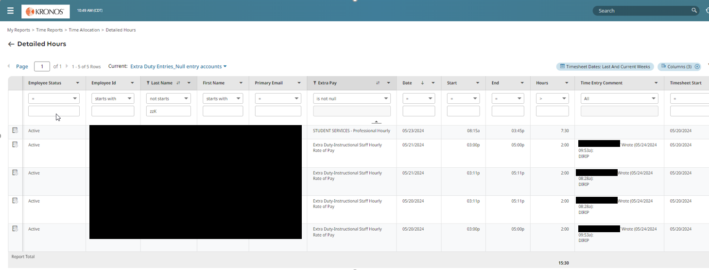
Helpful report for Extra Duty
“Extra Duty Entries_Null entry accounts”
-Shows you what Extra Duties your employees have selected for a given time period.
-Can be run on demand or scheduled.
Notes:
Already have access to this under Reports>My Saved Reports but separate instruction document coming out

Slide 6
Need help?
-Account Coding: Budgeting Department (https://www.escambiaschools.org/budgeting)
-Timesheet Issues: Payroll (https://www.escambiaschools.org/payroll)
-Request for training/Questions: Payroll/Anya Klinginsmith/Dasia Williams
-Who is responsible for a Extra Duty: Cost Center Manager directory (available on Payroll website)
-Badge malfunction/Timeclock issues: ithelp@ecsdfl.us

Slide 7
Employee

Slide 8
What is the employee responsible for?
-Clocking in/out for scheduled time (depending on employee type)
-Clocking in through Extra Duty and then clocking out
-Extra Duty selection
-Adding notes (when required)
-Submit timesheets
-Change Requests
-Time Off requests
Notes:
All the same responsibilities.

Slide 9
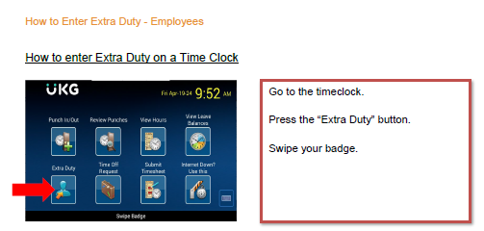
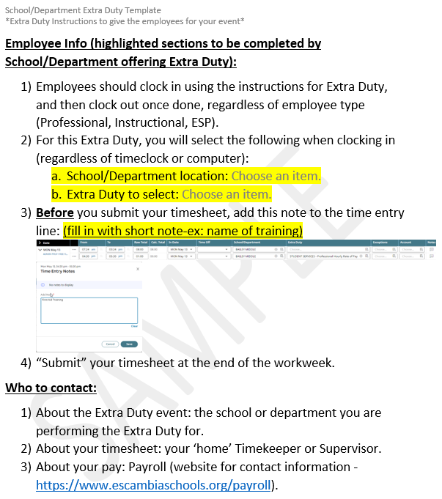
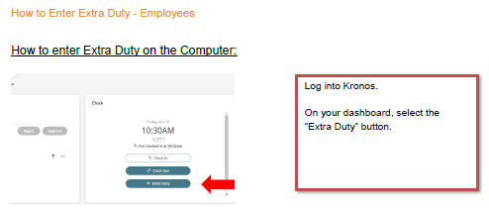
What does it look like?
Notes:
Sample instructions employees should be receiving from departments (some have used an email but the key pieces of information should still be included-what School/Department to select; which Extra Duty to use; what Note to add; and a reminder to submit their timesheet.

Slide 10
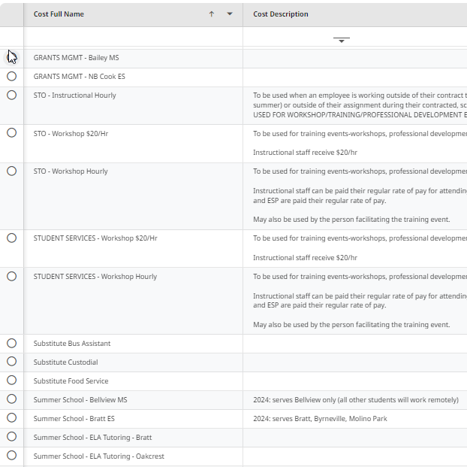
Notes:
Extra Duty options will be limited by the employee’s position type - administrative, instructional, professional, ESP. If a group cannot use the Extra Duty, it will not be visible to them, nor can it be selected for them by a Cost Center Manager, Timekeeper, or Supervisor. As we move through this process, these will be refined and descriptions updated. This is the view from an Instructional perspective-you do not see any mention of Professional or ESP.
The directory of Cost Center Managers will be updated regularly and will be found on the Payroll website.
Again, it is important the employee selects the correct Extra Duty-doing so helps ensure they are paid timely because if they’re wrong-it can take a bit to get it all sorted and corrected.

Slide 11
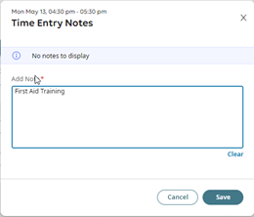
Adding a Note (if needed):
Notes:
Employees may be asked to add notes for their Extra Duty (name of training, for example). This is done directly on the employee’s timesheet.

Slide 12

Think: “verify delivery address before ordering” (or, in Kronos terms: “make sure you’ve got the right extra duties before submitting”)
Notes:
Just like making purchases online goes more smoothly when you have all the right information before ordering, so is the same with Kronos. We’re going to look at this a little more closely now.

Slide 13
Cost Center Managers

Slide 14
What Are the Cost Center Managers Responsible For?
-Work with Finance Depts to set up Extra Duty
-Provide instructions to employees on what School/Department location and Extra Duty should be selected
-Instruct employees what to add as a note on the timesheet (if needed)
-Limited corrections of Time Entry fields
Verification of Time Entry for selected Extra Duty
Add coding
Approve/Submit the Time Entries
-Review reports as needed to be proactive and also correct issues
Common questions:
Can a Timekeeper or Supervisor also be a Cost Center Manager? YES
How? Possible ways: (a) If the employee works at the site, then likely the Timekeeper or Supervisor would be the person who could verify their time entries; (b) If a site is given money to handle their own Extra Duty (ex: Workshop), then you would be responsible for the time verification and coding.

Slide 15
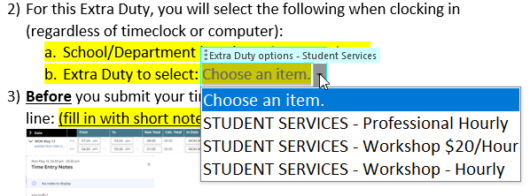
Note about the Instructions Employees should get
Notes:
This is a template that has been provided to the departments. For the schools, a similar one will be provided which, after downloading to open in WORD, can utilize the drop down options to identify which Extra Duty to select. Key pieces: notifying employees what they need to select for both the location and the Extra Duty.

Slide 16
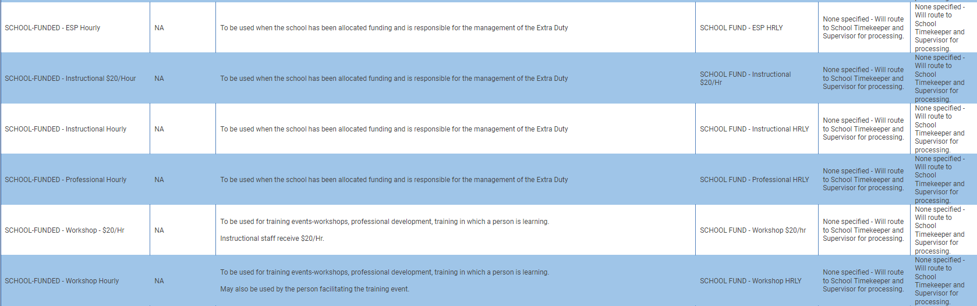
A note about “School-Funded” Extra Duties
Notes:
For Schools: when a department allocates money to your school and YOU are in charge of how it is spent (Curriculum Development, Parent Nights, Training events, etc.), you would use the applicable option as shown above to instruct your employees on what to select. The time entries will then route to you (Timekeeper/Supervisor) to review/approve.

Slide 17
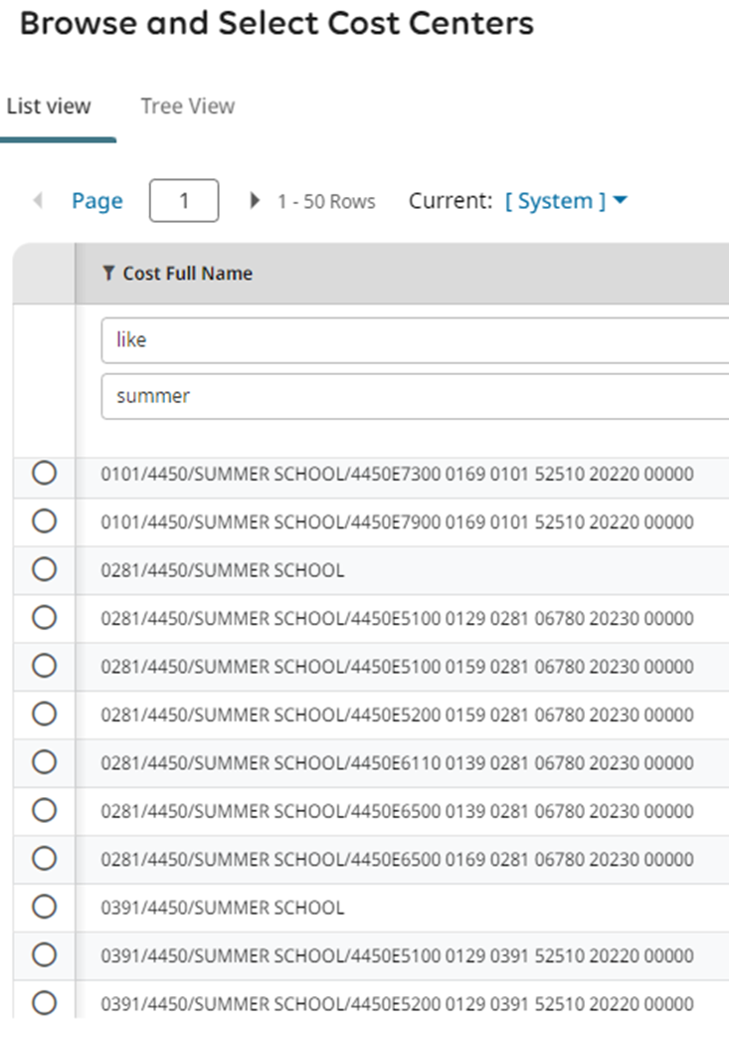
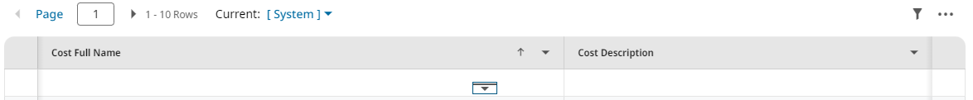
Account Coding
-Filtering is your friend when searching for Account Coding.
-Be EXTRA CAUTIOUS WHEN SELECTING CODING during the summer months: you will see more than one location since many employees are working at different locations.
Pro-tip: use “like” to narrow your search.
“0101” is Bratt
“0281” is Escambia HS
Pro-tip: click on this icon to expand the view and have filtering options.
“0391” is Oakcrest
Notes:
Again, based on how your site runs, you may or may not have much to do with Account Coding but in case you do, or because there are multiple areas of Kronos that you can use filtering (Extra Duty options, reports, School/Department locations), we’ll touch on it here.

Slide 18
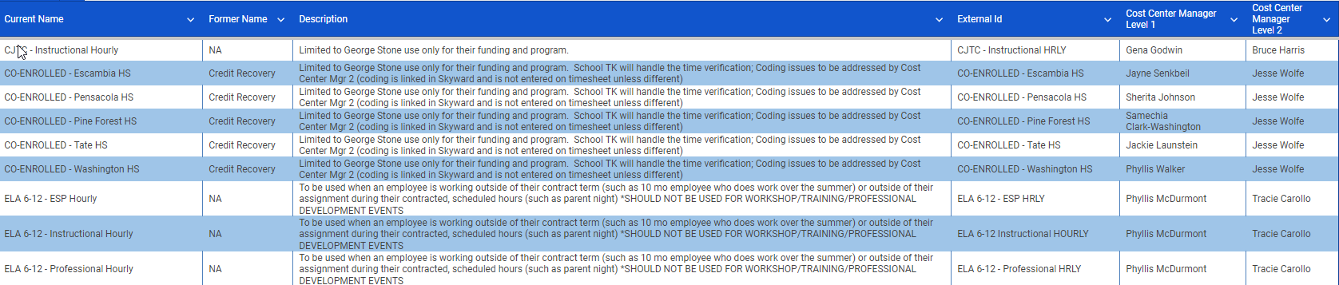
Directory for Extra Duty
-July changes: adding some, removing others, changing names, adding descriptions (as needed)
-There will be an additional column providing the former name. As we continue into the new school year, that will eventually drop off.
Notes:
Maintained and available on the Payroll website.

Slide 19
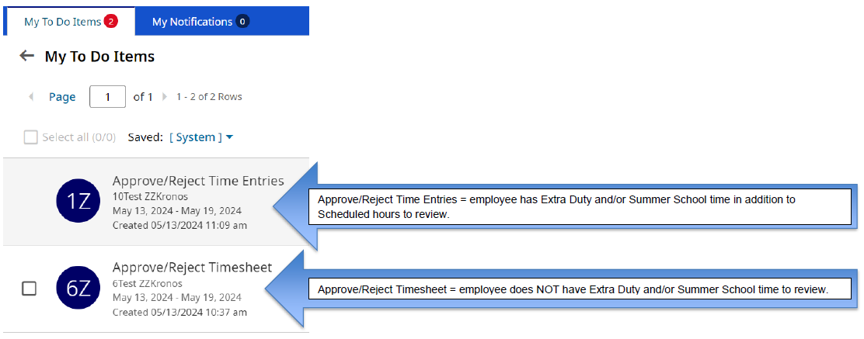
Approving Time Entries vs. Timesheets
Notes:
Key differences between Time Entries and Timesheets: loss of “checkbox” and name. I go to “My Mailbox” to see this information.

Slide 20
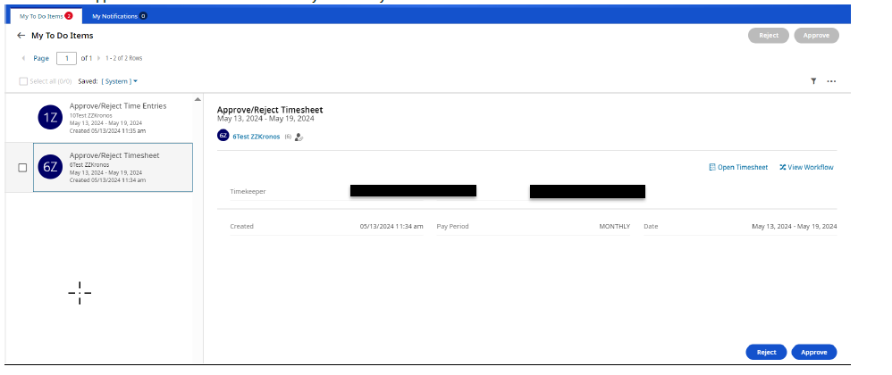
Timesheet view
Notes:
Timesheet view-have Timekeeper/Supervisor information (a few places only have a Supervisor so the Timekeeper will not be listed).
Can still process as usual directly from this screen or in the timesheet.
There are a few areas that do not have Timekeepers so there are different instructions that will be emailed separately.

Slide 21
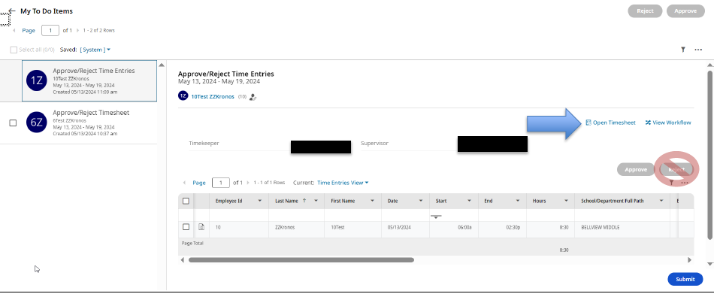
Time Entry view
Notes:
Time Entries view-have the Timekeeper/Supervisor information as well.
More views/information in the “Extra Duty Instructions for Cost Centers” document.
The entries you see in this view are related to the employee’s scheduled hours.
Unless asked, in general, department Extra Duty entries should not be touched - AFTER the employee submits their timesheet, the time entries go to the Cost Center Managers first.

Slide 22
Timekeepers/Supervisors

Slide 23
What is the Timekeeper or Supervisor Responsible for?
What is the Timekeeper or Supervisor generally NOT Responsible for?
-Remind employees to:
Select the correct Extra Duty
Clock in and out for Extra Duty
Add notes (if needed)
Submit timesheets
-Approve Change Requests
-Time Off requests
-Internal Funds tab entries
-Processing Timesheets and Time Entries by the posted deadlines of Payroll
-MAY attach documents/notes to the timesheet
-MAY be asked to assist Cost Center Managers
-IF it is a “School-funded” Extra Duty, then you may step into a Cost Center Manager role
-Adding comments if you make a change directly to the employee’s timesheet (as of July 1st)
-Entering Extra Duty on behalf of the employee (exception: Internal Funds tab)
-Unless asked/needed, should not be modifying Department Extra Duties
Notes:
Many of the same responsibilities are in place. As we move along in the process, Timekeepers and Supervisors should be relying on the Cost Center Managers to manage the Extra Duties-add coding, verify time, etc. What you see will vary by how your location is set up. Change Requests will need to be processed timely-especially before the employee submits their timesheet for the week.

Slide 24
Demo and question time!
Notes:
Log into system-run with
1Test (Alt Ed) IAP, wk of 7/8/2024 - Hope: Donna Krchak and Dawn Gibbs; Science Workshop (Debra Early-Magouyrk; Cheyenna Novotny)
6Test (MS) IAP, wk of 7/8/2024 - Bailey: Tara P. and Karen L.; ELA Workshop (Marjorie “Phyllis” Mcdurmont; Lisa Marsh)
13Test (HS) ESP, wk of 7/8/2024 - PFHS: Samechia C. and Melanie M.; Sub Bus Driver (Sarah Nanny/Jennifer Repine)
2Test (ES) ESP, wk of 7/8/2024 - Longleaf: Mona P. and Troy B.; Sub Bus Driver (Sarah Nanny/Jennifer Repine)
July 24th: 2Test (ES) ESP, wk of 7/22/2024 - Longleaf: Mona P. and Troy B.; Sub Bus Driver (Sarah Nanny/Jennifer Repine)
July 25th: 1Test (ES) IAP, wk of 7/15/2024 - Longleaf: Mona P. and Troy B.; Science Workshop (Debra Early-Magouyrk; Cheyenna Novotny)
July 26th (1p): 1Test (Makeup) IAP, wk of 7/22/2024 - Longleaf: Mona P. and Troy B.; Science Workshop (Debra Early-Magouyrk; Cheyenna Novotny)
July 26th (3p): 13Test (Makeup) ESP, wk of 7/15/2024 - PFHS: Samechia C. and Melanie M.; Sub Bus Driver (Sarah Nanny/Jennifer Repine)

